Slide 1

ROckbuster
December 2023
Data Analysis Project
BI Department
Link to Tableau
Pourya Ebrahimi

Slide 2
Intro
Facing stiff competition from streaming services such as Netflix and Amazon Prime, the our management team is planning to use our existing movie licenses to launch an online video rental service in order to stay competitive.
Of course the way in front of us would not be easy and needs lots of efforts in all departments as well as BI department in the front line.
In the meeting we have been asked to answer some crucial business questions that we will try to address in this presentation.
Q. Which movies contributed the most/least to revenue gain?
Q. What was the average rental duration for all videos?
Q. Which countries are Rockbuster customers based in?
Q. Where are customers with a high lifetime value based?
Q. Do sales figures vary between geographic regions?

Slide 3
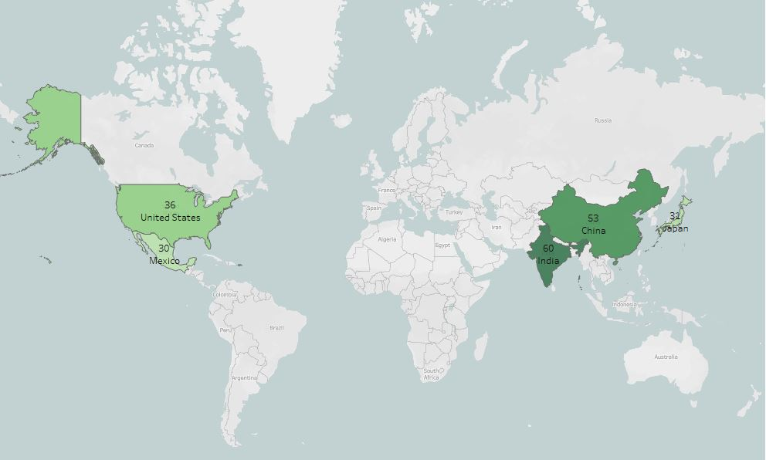
In which countries ?
As being showed on the map below out Top 5 countries with the most customers are:
1.India
2.China
3.United States
4.Japan
5.Mexico
MOVIES

Slide 4
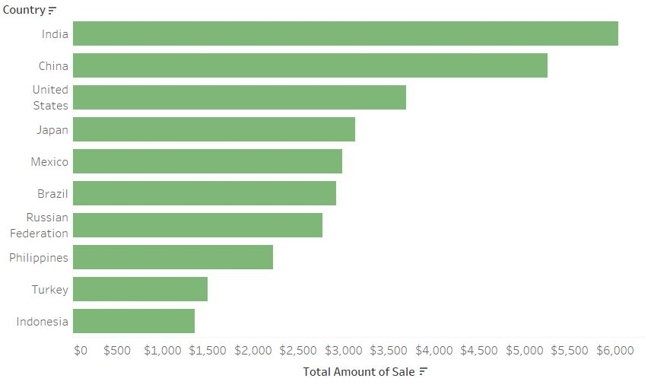
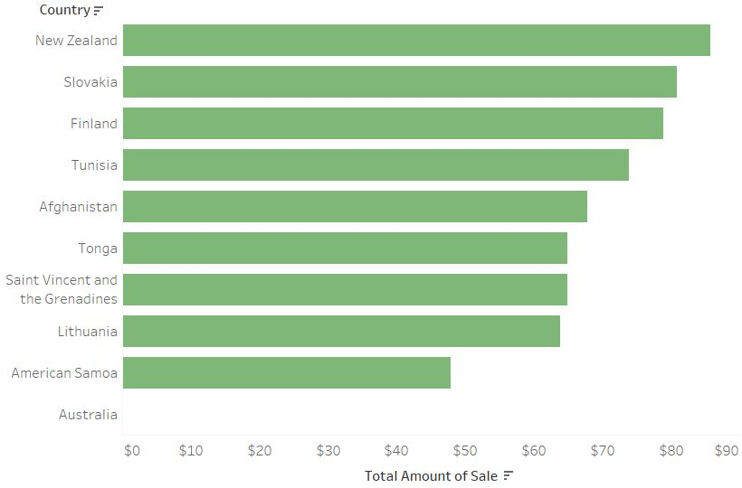
Sale Amount
Here you can see countries with the most and the least amount of sale.

Slide 5
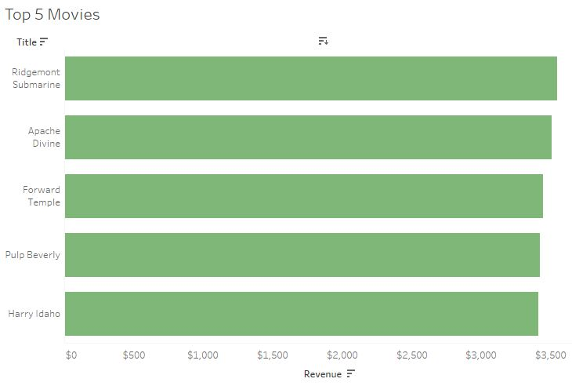
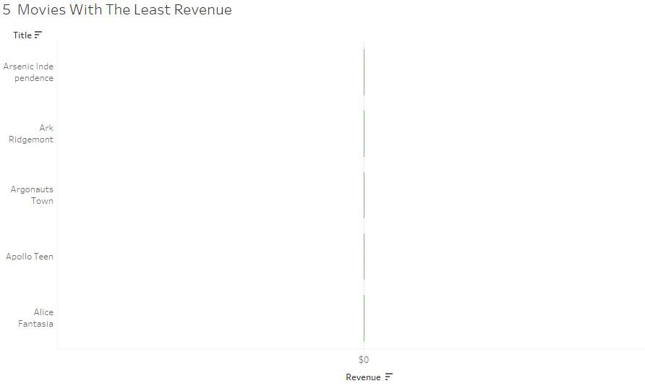
Best and Worst Movies

Slide 6
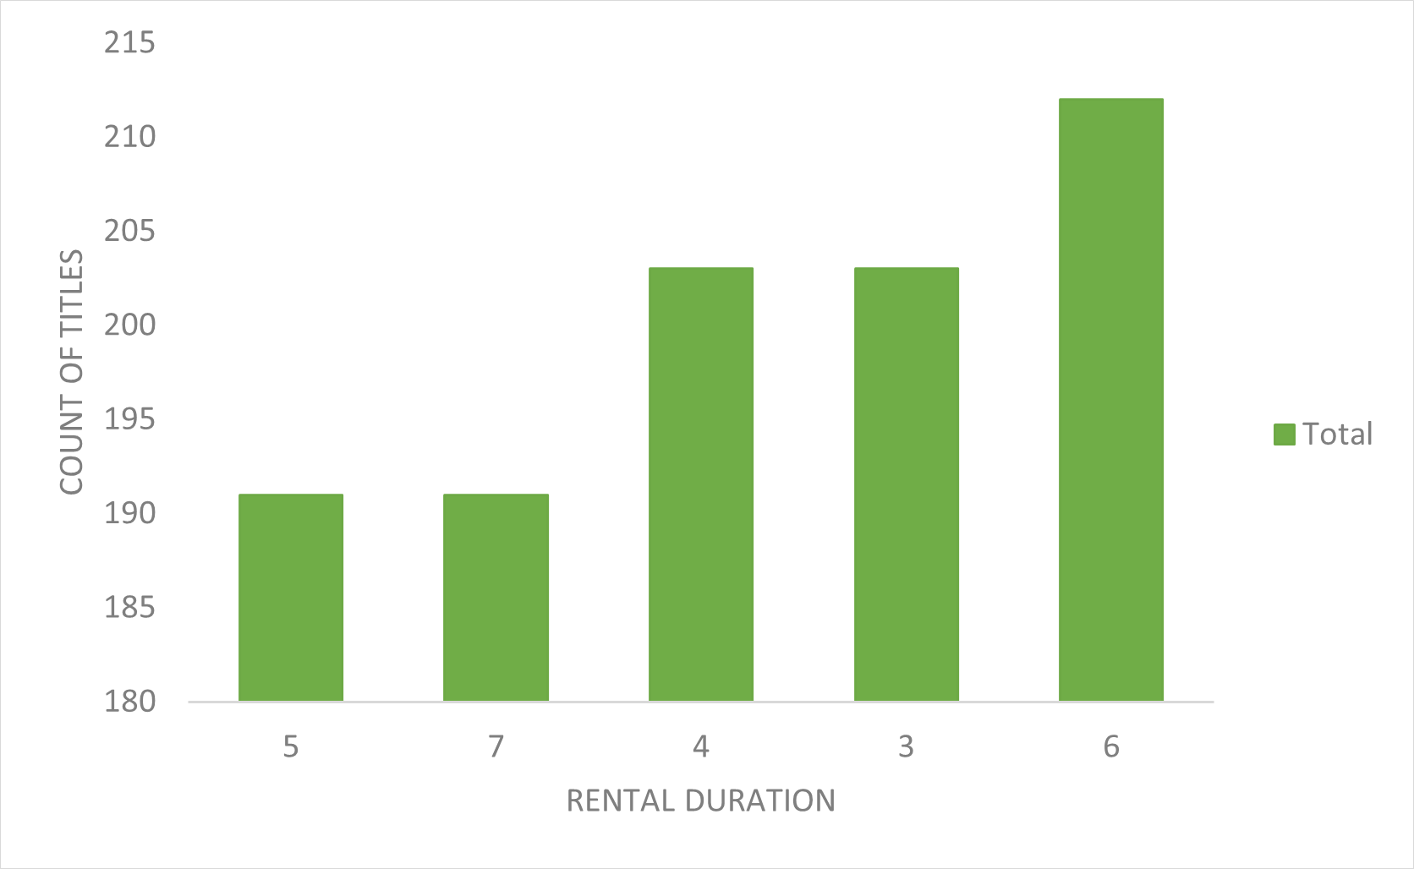
Rental Duration
Maximum
7 Days
Average
5 Days
Minimum
3 Days

Slide 7
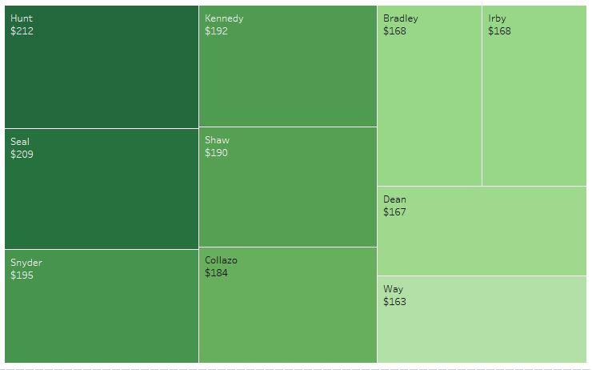
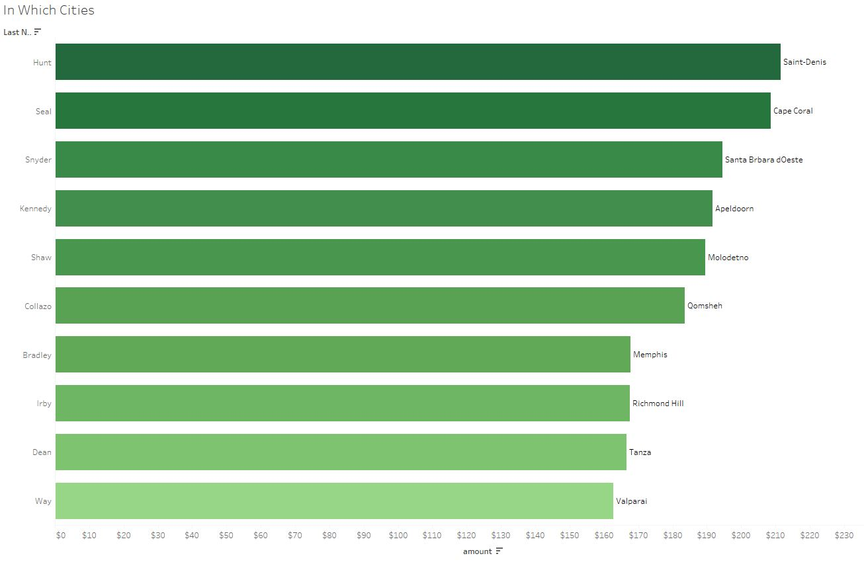
Best customers
In charts below, we can see our top 10 customers and their city of residence.

Slide 8
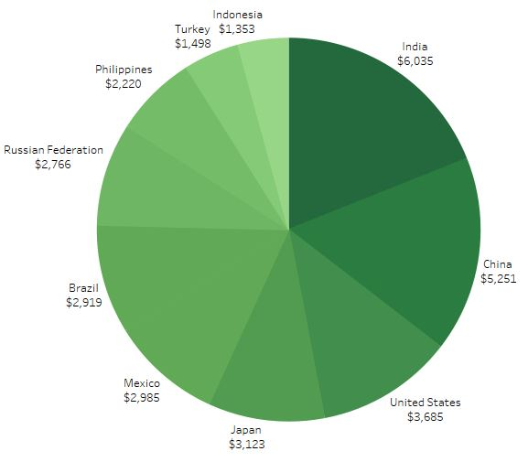
Recommendations
-As we can see, 10 countries
contributing more than 30% of our
sales.
Understanding customer preferences
in Genres and movies within these
markets is crucial.
Localization Strategies:
-Consider synchronization options, particularly for Spanish and Portuguese audiences.
Customer Loyalty Initiatives:
-Develop special gifts and packages for our loyal customers.
-Enhance the customer experience to foster a sense of exclusivity.
AI Integration for Customer Insights:
-Implement AI algorithms to analyze customer behavior and forecast their needs.
-Leverage technology to tailor our offerings and services based on customer preferences.

